Slide 1

How to be Successful in High School
Pave the road to your dream college
Presenter
Mrs. Rajini Sundararaj
04/19/2026

Slide 2
Graduation Credits- Depends on the county (21, 22, 23, or 24)
English: 4 credits (including 9th Grade Literature and American Literature).
Mathematics: 4 credits (including Algebra I, Geometry, Algebra II, and a fourth math).
Science: 4 credits (Biology; Physical Science/Physics; Chemistry/Earth Systems/Environmental Science; and a fourth science).
Social Studies: 3 credits (World History, U.S. History, Government, and Economics).
Health and Personal Fitness: 1 credit (0.5 of each).
CTAE, Fine Arts, or Modern Language: 3 credits required.
Electives: 4 credits- based on your interest and career goal you can schoose
Assessments: Students must take EOC tests/Milestone Exam for American Literature, Algebra I, Biology, and U.S. History.
Notes:
.

Slide 3
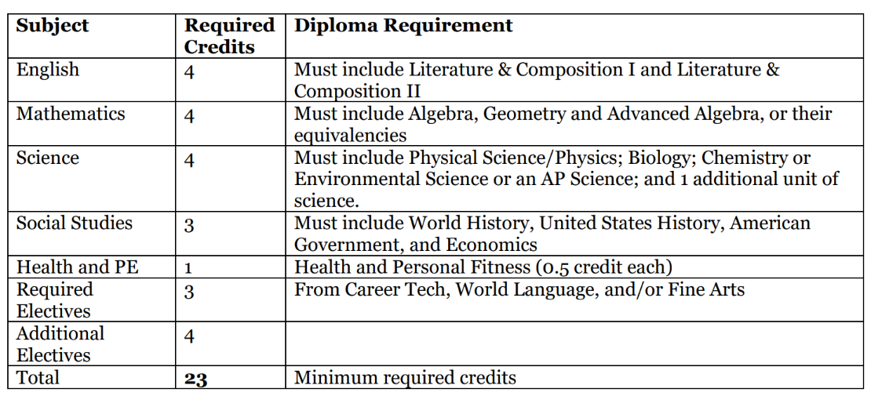
Cobb County Public Schools

Slide 4
Promotion Requirements:
To 10th Grade - Students must earn a minimum of five units -including one full credit in English, math, and science.
To 11th Grade - Students must earn a minimum of ten units - including two full credits in English, math, and science.
To 12th Grade - Student must earn a minimum of sixteen units
Honors courses receive an extra 0.5 quality point. Honors courses are designated in the course section of the
booklet with two asterisks (**). Advanced Placement courses are awarded an extra 1.0 quality point
Students can meet with their school counselor to request additional courses aligned with their career interests and to boost their GPA.

Slide 5
Checkpoints for Success
01
02
Strong Academic Profile
Extracurriculars
03
04
College applications (including essays and recommendation letters)
Opportunities & Scholarships

Slide 6
Build a Strong Academic Profile
Core GPA (e.g. English, Math, Science, Social Studies)
AP/Honors Courses (Rigorous courses)
SAT/ACT Scores-Middle 50th percentile
(For your dream school, aim to score in the top 25% of students nationally on the SAT or ACT. For most selective colleges, that usually means a SAT above 1500 or an ACT above 33).
Dual Enrollment-(College-level courses in high school)
Be versatile; choose at least one of these pathways
Fine/Performing Arts
Language(s)
CTAE- Career, Technical, and Agricultural Education

Slide 7
Importance of PSAT/NMSQT
National Merit Scholarship : Eligibility and Selection Steps
1. Based on PSAT (Junior Year)
The PSAT/NMSQT taken in 11th grade is the qualifying test.-SAT/National Merit Scholarship Qualifying Test (PSAT/NMSQT), which served as an initial screen of program entrants.
2. Top 1% = Semifinalist (It’s state-based, not just national ranking)
✔️ Roughly the top 1% of students in each state become National Merit Semifinalists
3. To become a Finalist - To move from Semifinalist → Finalist, students must:
✔️ Have a strong GPA (consistent academic performance)
✔️ Submit an application (including essay)
✔️ Provide SAT or ACT scores that confirm the PSAT performance
✔️ Show school recommendation
✔️ Demonstrate extracurricular involvement & leadership
https://blog.collegevine.com/national-merit-scholarship-full-ride

Slide 8

2026 National Merit Scholarip Winners
Just 16,000 students out of over 1.5 million test takers are recognized as Semifinalists!
Over 15,000 Semifinalists met the requirements to become Finalists.
About half of the Finalists will be selected as Merit Scholarship winners in 2025.
No citizenship status is required.

Slide 9
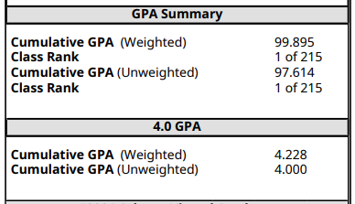
Students can have either two or three grade point averages, depending on their county.
Cumulative GPA:
One on a 100 point scale
One on a 4.00 scale
One on a 5.0 scale if you have taken a AP/Dual enrollment course
Grade Point Average

Slide 10
GPA
Your gpa and rank is formulated by the grades you earn.
GPA Calculator
The higher your grades-the higher your gpa/rank.
GPA Converter

Slide 11

Your class rank is determined by comparing your GPA to the GPA of people in the same grade as you.
Class Rank

Slide 12

Georgia Students also have a Hope GPA Generated by core courses only:
English
Math
Science
Social Studies
World Language
HOPE / Scholarship GPA: This GPA is calculated using a specific formula set by the state for scholarship eligibility. It may not match your school GPA exactly because some classes are counted differently.
HOPE GPA-Found in GAFUTURES

Slide 13
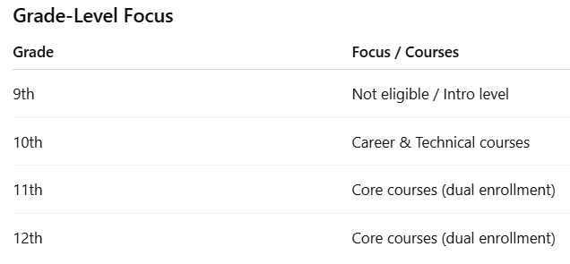
Dual Enrollment Criteria
High school students take college-level courses while still in high school.
They earn both high school and college credit at the same time.
Courses can be taken at a local college/university or online.-( in all three terms)
(community or state colleges)
Maximum 30 credits allowed
Georgia Futures – Dual Enrollment Program https://www.gafutures.org/hope-state-aid-programs/scholarships-grants/dual-enrollment/
GA Futures tracks core classes and eligible universities
11th & 12th grade core classes often count as electives at outside colleges, still earning college credit

Slide 14
2. Extracurriculars- Show your versatile involment
School Clubs
Service-oriented (e.g. Interact clubs)
Competitive clubs (e.g. Science Olympiad, Math team)
Cultural Identity
Volunteering
Athletics (Varsity/JV)
Science & Engineering Fairs (e.g. Regional, GSEF, ISEF)

Slide 15
School Clubs
Science National Honors Society
National Honors Society
Rotary/Key/Interact Club
Regional Language School
Student Leadership Council / Student Government Association
SEM Link Journal Club-
Future Business Leaders of America (FBLA)
Distributive Education Clubs of America (DECA)
Health Occupations Students of America (HOSA)
https://schoolhouse.world/
Service-Oriented (Community & Leadership)
Los Niños Primero
Eco-warriors Club
ENGin (English Tutor for Ukrainian ESL Students)
Volunteered at science workshops, AP preparation sessions, and community STEM events across local schools.
STEM Outreach Volunteer – Atlanta Science Festival
American red cross
Competitive Clubs / Academic Teams
Science Olympiad
Schoolhouse.world (competitive tutoring / academic engagement)
FBLA competitions
Science & Engineering Fairs / STEM Competitions
SEM Link Journal Club (if STEM research projects)
Cultural Identity
Spanish or Latinx Club
Language Clubs: Spanish Club, French Club
Cultural Festivals: Diwali, Cinco de Mayo celebrations
Community Programs / Volunteering: Los Niños Primero, local cultural organizations
Get involved in GAMA activities
Athletics
Sports Club
Team Sports (e.g. Soccer, Basketball, Football)
Individual Sports (e.g. Tennis, Golf, Track & Field)
Fitness & Performance Activities: Cheerleading, Dance Team, Weightlifting, Yoga (usually outside of school)
Emerging & Alternative Sports: Esports, Ultimate Frisbee, Fencing, Rowing, Pickleball (usually outside of school)

Slide 16
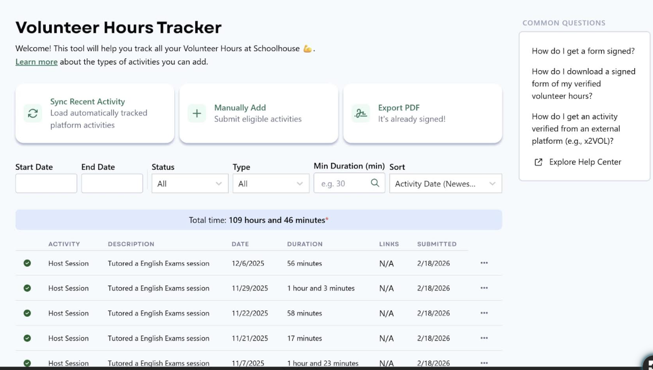
Schoolhouse.world
An online learning community where you can tutor and/or learn!)
College Admission Partners

Slide 17
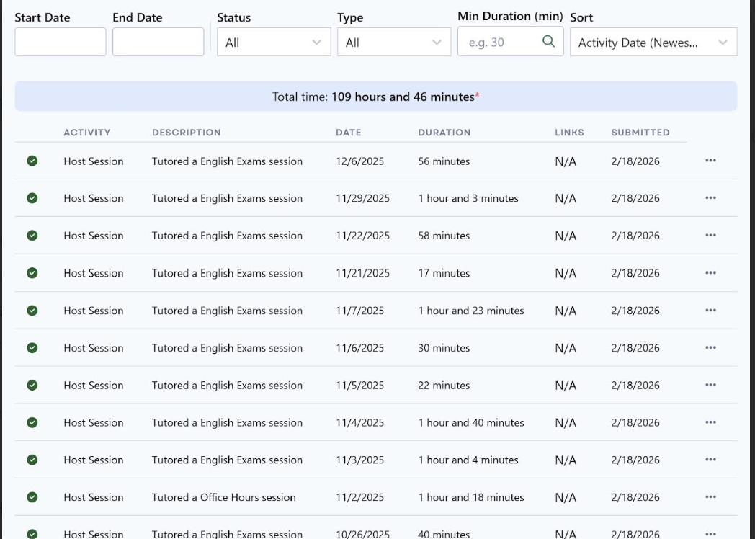

Slide 18
Professional Internships / Fellowships
https://www.gradyhealth.org/health-outcomes-at-grady/teen-experience-and-leadership-program
https://med.aws.emory.edu/departments/human-genetics/next-gen.html?utm_source
Karim Kharbouch Coding Fellowship (KKCF)-https://www.theknowledgehouse.org/apply/
https://www.hfyny.org/ Hope For Youth
R.E.A.L.- Georgia Tech Internship-https://ceismc.gatech.edu/gift/real
Pre-College Summer Programs

Slide 19
3. Opportunities & Scholarships
State-based Merit Aid (check on GA Futures)
HOPE
Zell Miller
National Level Financial Aid
FAFSA -Free Application for Federal Aid
CSS Profile- College Scholarship Service.
Scholarships
CollegeBoard BigFuture
Niche Scholarships
National Merit

Slide 20
3. Opportunities & Scholarships
Database | Key Features
Fastweb | One of the oldest and largest databases; every listing is verified to prevent scams & provides personalized matches.
Scholarships.com | Easy to find local & specialized scholarships (e.g. specific majors or hobbies); great search tools
BigFuture (College Board) | Integrates with your College Board profile & includes over $4 billion in annual funding
Scholarships360 | Verified listings by a research team; deadlines and links are always updated & current
Bold.org | Features "exclusive" scholarships you won't find on other sites. Many are "no-essay" or based on your Bold profile.
CareerOneStop | Sponsored by the U.S. Department of Labor; this search tool allows you to filter scholarships by state and level of study

Slide 21
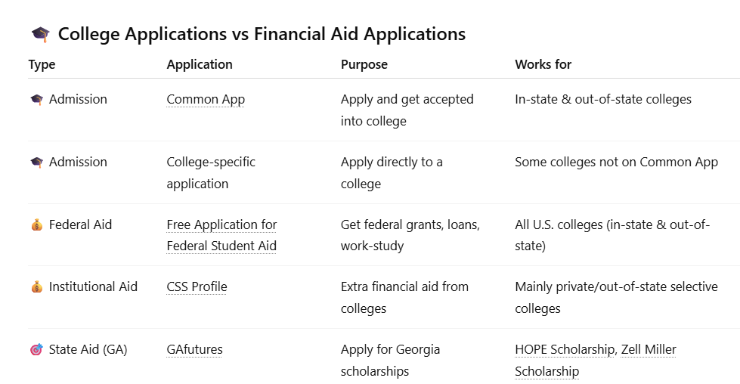

Slide 22
4. College Application Component / Personal Essay
Recommendation Letters

Slide 23
College Application Component
Essay Writing Tips
Recommendation Letters
Centralized Application Platforms:
The most common is the Common Application (CommonApp)
Accepted by 1,000+ public and private colleges
Allows you to apply to 20+ schools using one platform
Coalition Application (via Scoir):
Accepted by 150+ colleges
Focuses on increasing access for underrepresented students
State-Specific Applications:
Examples include the University of California Application and ApplyTexas
Used for public colleges within specific states
Institutional (Direct) Applications:
Some colleges have their own application systems
Certain selective universities require this (e.g., MIT, Georgetown University)
CommonApp Requirements (most widely used):
Personal information
Up to 5 honors/awards
Up to 10 extracurricular activities
A personal statement essay describing significant experiences
Word Limit:
The personal essay should be 650 words or less
Preparation Tips:
Read sample Common App essays available online
Explore helpful websites and YouTube videos for guidance
Over the summer after junior year
Review and revise several times
What Makes a Strong Essay:
Be authentic, unique, and true to yourself and Choose a topic that is memorable to the admissions officer
Write from the heart to stand out among thousands of essays
Personal and specific
Story-based (not general advice)
Reflective (show growth or insight)
Choose a teacher with whom you have a strong connection and who knows you well and can speak to your strengths
Maximum of 3 letters are typically needed
If pursuing a STEM major, ask at least one science or math teacher
One letter from your counselor and two from your core subject teachers
Request letters in early spring of your junior year because some teachers have a limited number of recommendation letters they can write.
Send a resume or brag sheet to your teacher
Consider asking in person by visiting the teacher’s classroom

Slide 24
Personal Preparedness
Log all activities in a document AND write a post-activity reflection
Stay active on LinkedIn! Find activities near you
Keep 2 resumes at all times—one long and one condensed
Stay organized using notes & calendar apps-Track your events, activities ,and assignment deadlines
Build a network—peers, teachers, professionals!
ALWAYS apply & try your best!
Confident & independent mindset
College- Start thinking about long term goals like college or careers.
Mental Health- Take care of your mental health and physical health.

Slide 25
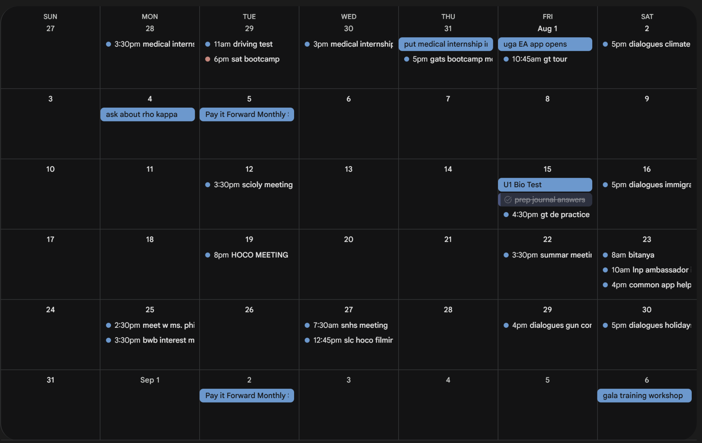
Student Recommendation

Slide 26
Sample Student Extracurriculars
Science National Honors Society
National Honors Society
Los Niños Primero
Regional Language School
Interact Club President
ENGin (English Tutor for Ukrainian ESL Students)
Science Olympiad
Schoolhouse.world
SEM Link Journal Club
Karim Kharbouch Coding Fellowship (KKCF)
Future Business Leaders of America (FBLA)
Medical Internship/Fellowship
Student Leadership Council/Student Government Association
GHP Semifinalist
JV Girls’ Tennis Team

Slide 27
Sample Student Honors & Awards
National Merit Finalist
Recognizes placement in the top 1% of high school juniors nationwide based on PSAT/NMSQT scores
AP Scholar with Distinction
Issued by CollegeBoard to students who receive an average score of at least 3.5 on all AP Exams taken, and scores of 3 or higher on five or more
Collegeboard’s National Recognition Program: School Recognition for Outstanding Academic Achievement
STEM Academy/Magnet Program
Academic Letter & Bar
FBLA Awards
Georgia/Global Seal of Biliteracy
Online Econ/Finance Competitions (e.g. Stevens Trading Day)
AP Capstone
Completion of AP Seminar + AP Research
Code for Impact Hackathon Winner
Designed a smart civic engagement platform, a website called Trash Talkers, to bring this technology to communities worldwide and empower citizens to clean up their neighborhood.
Find more hackathons on Devpost!

Slide 28


Slide 29
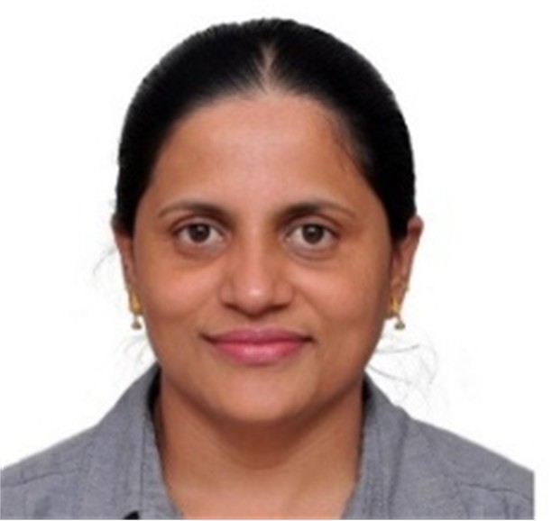
Thank you!
rajini.sundararaj@gmail.com

